Slide 1
Reputation Voting System UI Screens
Work in progress

Slide 2
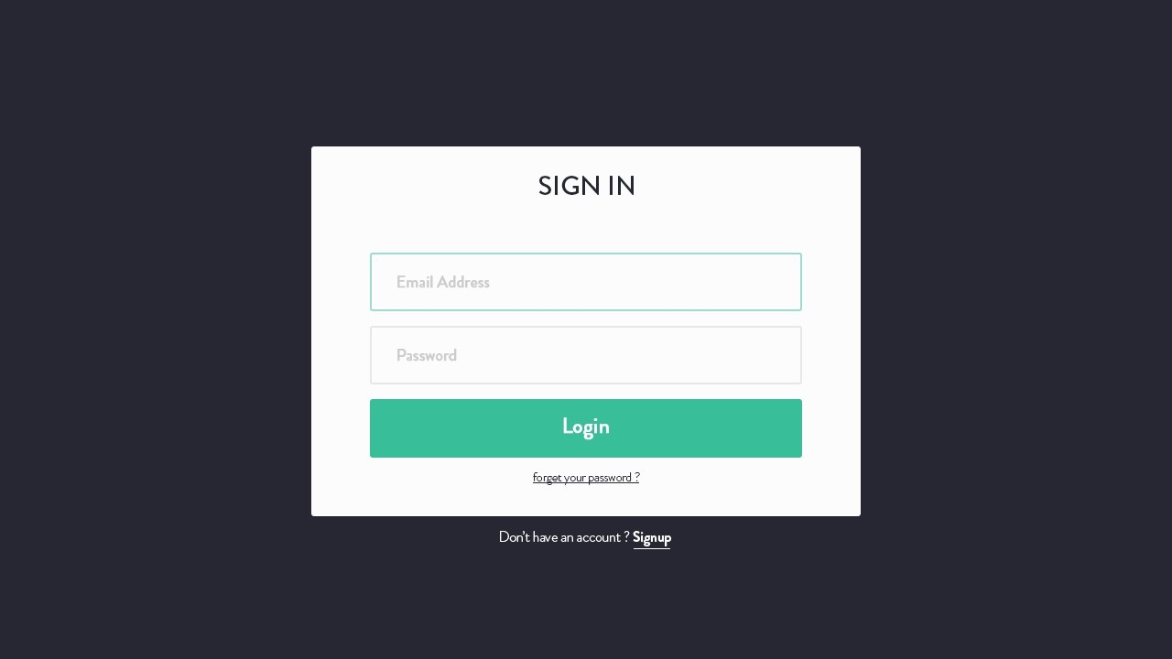
Home page | Signup / Login

Slide 3
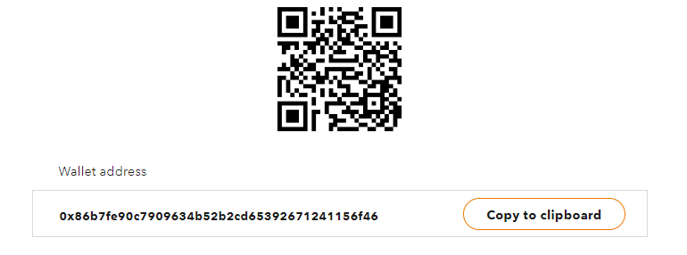
Screen combines proposal upload & ETH payment
Home Submit Proposal Proposal Status New Protocols Balance: 25 SEM Logout
Upload
Payment Status:
Submit
Waiting for deposit to:
0x86b7fe90c7909634b52b2cd65392671241156f46
Please allow some time (up to several hours) for transaction to be confirmed on Ethereum blockchain
Please send
.001 ETH to
This address
0.0001 ETH = 50 SEM
Gas (dynamically calculated): 0x98680F (1 wei)

Slide 4
Transaction confirmed
Note: after the payment has been confirmed, it redirects to Proposal Status
Home Submit Proposal Proposal Status New Protocols Balance: 50 SEM Logout
Payment Status:
Your payment has been confirmed.
confirmation 24 { blockHash:
'0xf7939d8b87e1b0a1dedca9b8aca01a28444c1096ba3c57ad7c6c9eee36480f48',
blockNumber: 3686739,
contractAddress: null,
cumulativeGasUsed: 627931,
from: '0x8d8f5159b1c09c631e7c728b23f59a0ffbc5694e',
gasUsed: 21000,
logs: [],
logsBloom:
'0x000000000000000000000000000000000000000000000000000000000000000000000000000000000000000000000000000000000000000000000000000000000000000000000000000000000000000000000000000000000000',
status: true,
to: '0xd34b67cf616f8995d3c7d660a2ca4ae1d684773e',
transactionHash:
Thank you for your payment. Your current balance is 50 SEM. Your proposal is submitted to the (...)
View Proposal Status

Slide 5
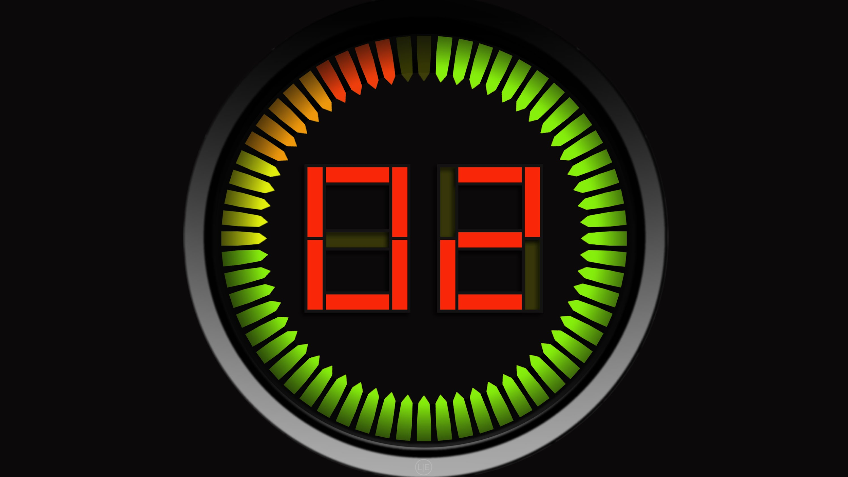
Proposal status
(Note: Votes are semi-random: skewed towards unanimous)
Home Submit Proposal Proposal Status New Protocols Balance: 25 SEM Logout
Vote Transactions:
TX# 0X0C979BBE3343AC72071808CE81D3CB84AEB2B4199AA5A35B5396EDF68E2D162C> 1 min ago
From 0xb1815b89083bd829742fe65e76c6610bb4d6e67c To 0x867f7cc73002a6453e4ccff405243c91c72bca2a
Vote: yea
TX# 0X95F35EF8B83DBBE608C691634FA0AEBF25A76FA592C5AD28F3604973DE841A6D> 1 min ago
From 0x5df8d8544975c1f549e567eff466719f596e51fc To 0x6cf1be8a293c654744767397ff510bf5133a8317
Vote: nay
TX# 0XD5E045B9943F115A914B0F081F697DDCD733E303E60DFFAFB7046F31953D76DC> 1 min ago
From 0x5c70d28514777a37464b1ea2b4b1819a8f9c14d0 To 0x5d6f6729ba4ea4d28baf4818430701905aff5643
Vote: yea
TX# 0X5E870AADD7F49F351555798D2BAA5FAB1CC2D450161033FCD7D46A3E543F6D47> 1 min ago
From 0xcc4e1c24914a216f5526cf6ebcfe0a12f278db6a To 0x24bdea74ec0ab87be0ee1c0e81fce4c26c841838
Vote: yea
Please wait while members are voting for your proposal:
Vote timeout is set to 60 seconds
Number of SEM Tokens Minted: 50
Total Number of [Name] DAO Members: 10
Minimum Quorum: 40% (4)
Betting pool SEM allocation: yea 50% : nay 50%

Slide 6
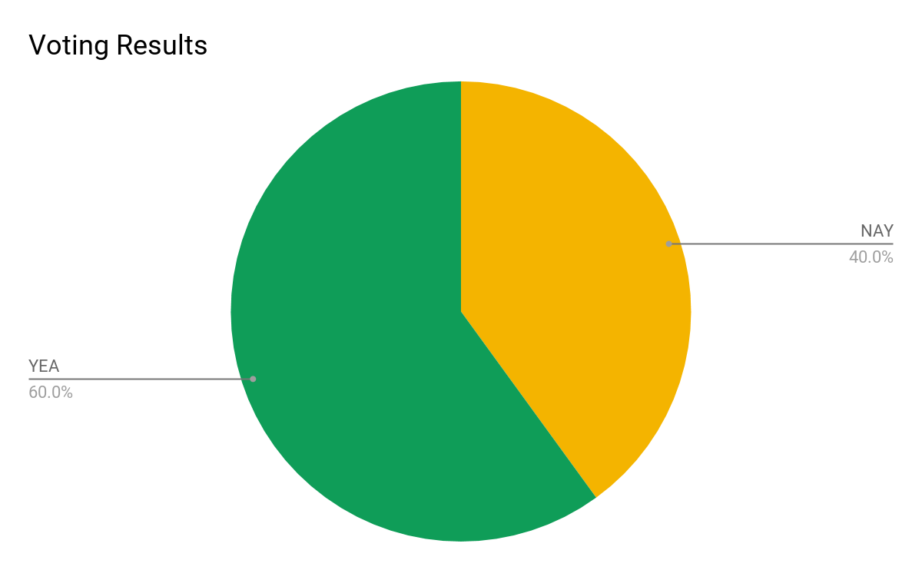
Proposal status
(Note: Votes are semi-random: skewed towards unanimous)
Home Submit Proposal Proposal Status New Protocols Balance: 25 SEM Logout
Minimum Quorum Reached: (50%)
YEA: 3
NAY: 2
Proposal status: PASSED!
SEM Token Distribution:
Original Poster (You): [...]
YEA Voters: [...]
NAY Voters: [...]
Your total SEM balance: [...]
Proof of SEM token Distribution:
Vote Transactions:
TX# 0X0C979BBE3343AC72071808CE81D3CB84AEB2B4199AA5A35B5396EDF68E2D162C> 1 min ago
TX# 0X0C979BBE3343AC72071808CE81D3CB84AEB2B4199AA5A35B5396EDF68E2D162C> 1 min ago
From 0xb1815b89083bd829742fe65e76c6610bb4d6e67c To 0x867f7cc73002a6453e4ccff405243c91c72bca2a
Vote: yea
TX# 0X95F35EF8B83DBBE608C691634FA0AEBF25A76FA592C5AD28F3604973DE841A6D> 1 min ago
From 0x5df8d8544975c1f549e567eff466719f596e51fc To 0x6cf1be8a293c654744767397ff510bf5133a8317
Vote: nay
TX# 0XD5E045B9943F115A914B0F081F697DDCD733E303E60DFFAFB7046F31953D76DC> 1 min ago
From 0x5c70d28514777a37464b1ea2b4b1819a8f9c14d0 To 0x5d6f6729ba4ea4d28baf4818430701905aff5643
Vote: yea
TX# 0X5E870AADD7F49F351555798D2BAA5FAB1CC2D450161033FCD7D46A3E543F6D47> 1 min ago
From 0xcc4e1c24914a216f5526cf6ebcfe0a12f278db6a To 0x24bdea74ec0ab87be0ee1c0e81fce4c26c841838
Vote: yea
Number of SEM Tokens Minted: 50
Total Number of [Name] DAO Members: 10
Minimum Quorum: 40% (4)
Betting pool SEM allocation: yea 50% : nay 50%

Slide 7
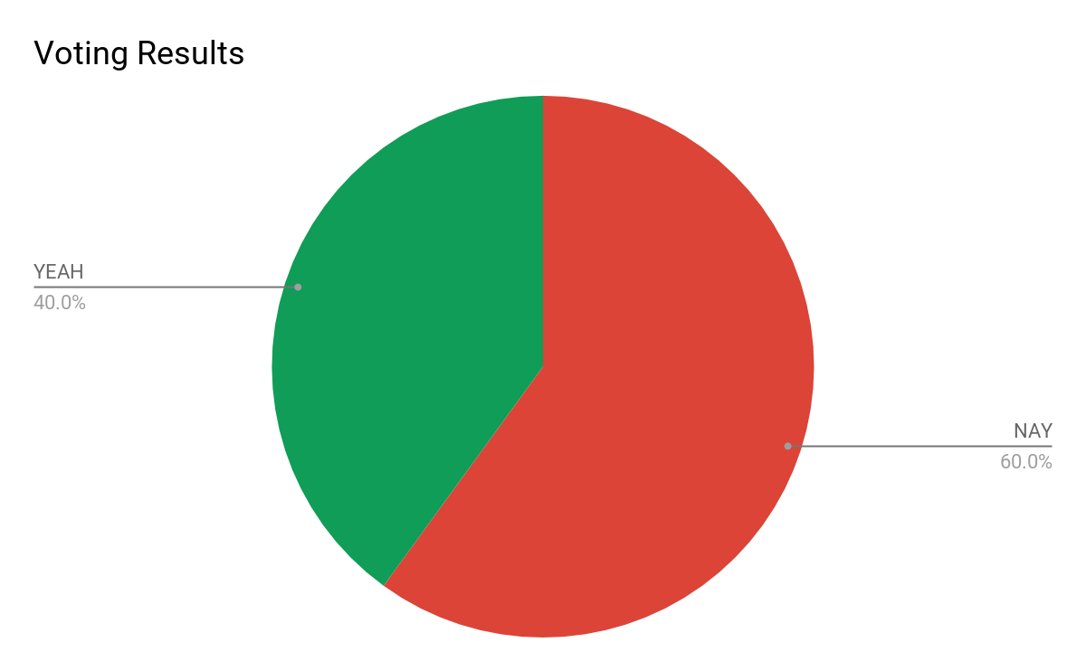
Proposal status
(Note: Votes are semi-random: skewed towards unanimous)
Home Submit Proposal Proposal Status New Protocols Balance: 25 SEM Logout
Minimum Quorum Reached: (50%)
YEA: 2
NAY: 3
Proposal status: FAILED
SEM Token Distribution:
Original Poster (You): [...]
YEA Voters: [...]
NAY Voters: [...]
Your total SEM balance: [...]
Proof of SEM token Distribution:
Vote Transactions:
TX# 0X0C979BBE3343AC72071808CE81D3CB84AEB2B4199AA5A35B5396EDF68E2D162C> 1 min ago
TX# 0X0C979BBE3343AC72071808CE81D3CB84AEB2B4199AA5A35B5396EDF68E2D162C> 1 min ago
From 0xb1815b89083bd829742fe65e76c6610bb4d6e67c To 0x867f7cc73002a6453e4ccff405243c91c72bca2a
Vote: yea
TX# 0X95F35EF8B83DBBE608C691634FA0AEBF25A76FA592C5AD28F3604973DE841A6D> 1 min ago
From 0x5df8d8544975c1f549e567eff466719f596e51fc To 0x6cf1be8a293c654744767397ff510bf5133a8317
Vote: nay
TX# 0XD5E045B9943F115A914B0F081F697DDCD733E303E60DFFAFB7046F31953D76DC> 1 min ago
From 0x5c70d28514777a37464b1ea2b4b1819a8f9c14d0 To 0x5d6f6729ba4ea4d28baf4818430701905aff5643
Vote: nay
TX# 0X5E870AADD7F49F351555798D2BAA5FAB1CC2D450161033FCD7D46A3E543F6D47> 1 min ago
From 0xcc4e1c24914a216f5526cf6ebcfe0a12f278db6a To 0x24bdea74ec0ab87be0ee1c0e81fce4c26c841838
Vote: nay
Number of SEM Tokens Minted: 50
Total Number of [Name] DAO Members: 10
Minimum Quorum: 40% (4)
Betting pool SEM allocation: yea 50% : nay 50%

Slide 8
New Protocol Vote Status
(Note: Votes are randomized)
Home Submit Proposal Proposal Status New Protocols Balance: 25 SEM Logout
Minimum Quorum Reached: (50%)
YEA: 3
NAY: 2
Proposal status: PASSED!
SEM Token Distribution:
N/A (no SEM is distributed after voting on DAO’s new protocols)
Proof of SEM token Distribution:
Vote Transactions:
TX# 0X0C979BBE3343AC72071808CE81D3CB84AEB2B4199AA5A35B5396EDF68E2D162C> 1 min ago
TX# 0X0C979BBE3343AC72071808CE81D3CB84AEB2B4199AA5A35B5396EDF68E2D162C> 1 min ago
From 0xb1815b89083bd829742fe65e76c6610bb4d6e67c To 0x867f7cc73002a6453e4ccff405243c91c72bca2a
Vote: yea
TX# 0X95F35EF8B83DBBE608C691634FA0AEBF25A76FA592C5AD28F3604973DE841A6D> 1 min ago
From 0x5df8d8544975c1f549e567eff466719f596e51fc To 0x6cf1be8a293c654744767397ff510bf5133a8317
Vote: nay
TX# 0XD5E045B9943F115A914B0F081F697DDCD733E303E60DFFAFB7046F31953D76DC> 1 min ago
From 0x5c70d28514777a37464b1ea2b4b1819a8f9c14d0 To 0x5d6f6729ba4ea4d28baf4818430701905aff5643
Vote: yea
TX# 0X5E870AADD7F49F351555798D2BAA5FAB1CC2D450161033FCD7D46A3E543F6D47> 1 min ago
From 0xcc4e1c24914a216f5526cf6ebcfe0a12f278db6a To 0x24bdea74ec0ab87be0ee1c0e81fce4c26c841838
Vote: yea
Number of SEM Tokens Minted: 50
Total Number of [Name] DAO Members: 10
Minimum Quorum: 40% (4)
Betting pool SEM allocation: yea 50% : nay 50% (no SEM distribution allowed)

